Slide 1
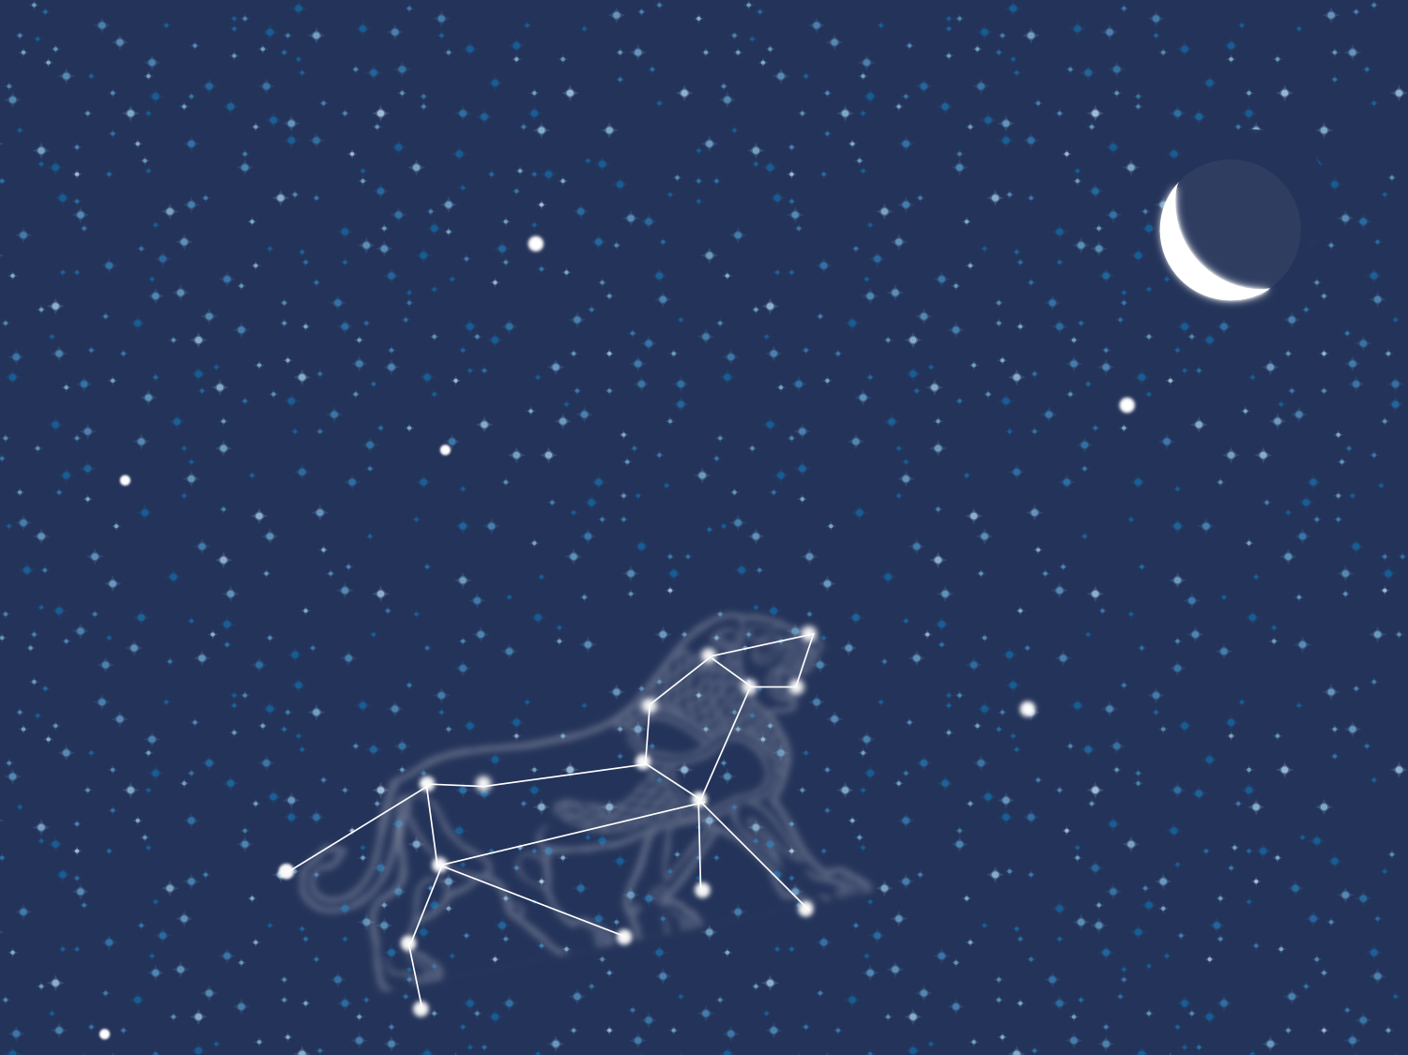
Information Design Patterns for Resilience and Sustainability
Shahryar Eivazzadeh
BTH University May 2012

Slide 2
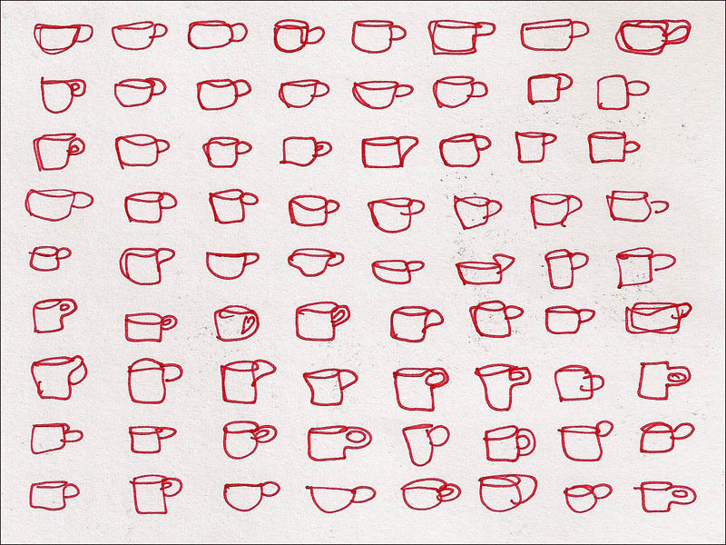
Design Patterns
http://www.amcofdata.com/images/Red-Cups.jpg
Notes:
Beyond all different designs resides design patterns, we want to find some informations ones which can create resiliency and sustainability

Slide 3
How we go from here …
(#Q) Questions
(#L) Literature Review
(#M) Information Dynamics Models
(#P) Patterns
(#R) Impact on Resilience
(#A) Application
Simulation of Application
Notes:
Create Model, Find patterns and prove them, apply one of those patterns in M

Slide 4

#Q Questions

Slide 5
#Q Questions
Is there any (and what are the) information pattern(s) that can make systems (especially product-services) more resilient and sustainable?
can we organize them as design patterns for later reuse in design process?

Slide 6
#L Literatures

Slide 7
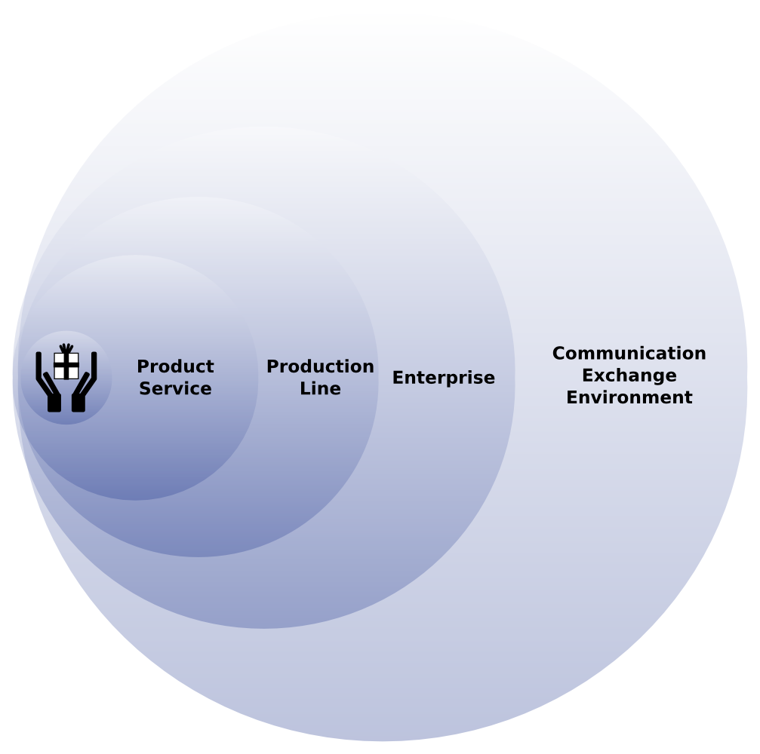
#L Product Service Systems Extended
Notes:
PPS in a quite extended view we use. Value on PSS, on production line, enterpisre, on …. Apply this extended view for future slides

Slide 8
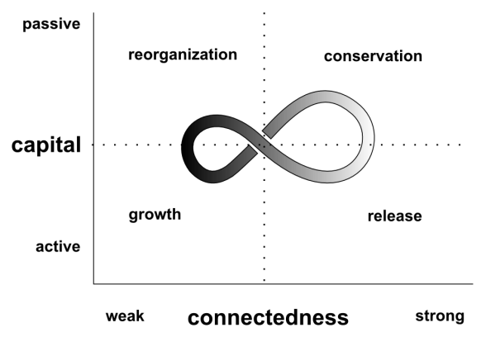
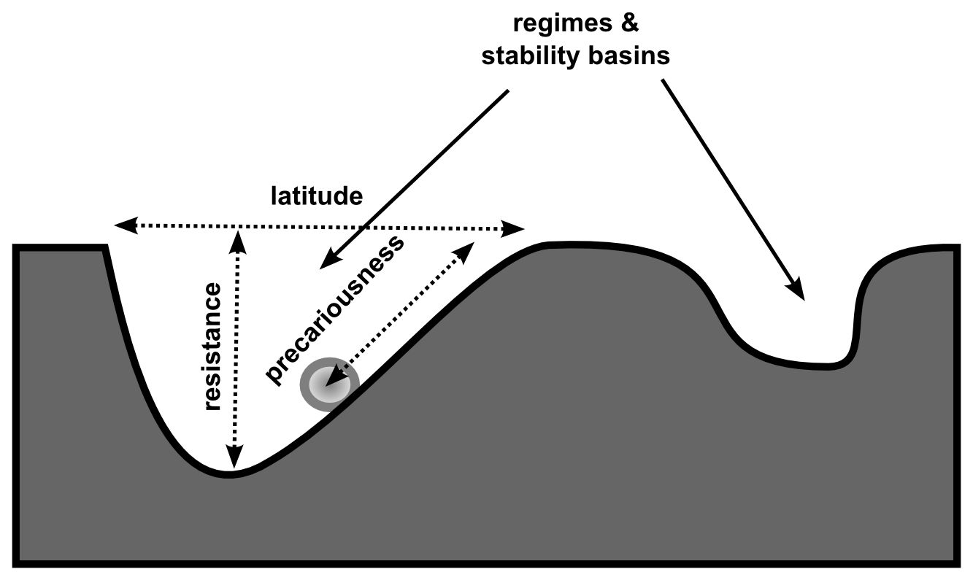
#L Resilience Theory
Panarchy
Notes:
Introduces 4 aspects to resilience. Stability metaphore, we are in good basin. . Latitude how much disturbance is tolerated, resistance how much we resist, precar how close we are to brinks

Slide 9

#L Resilience and Sustainability
Notes:
Res is superset , sustainablity is the holistic extendt , it includes

Slide 10
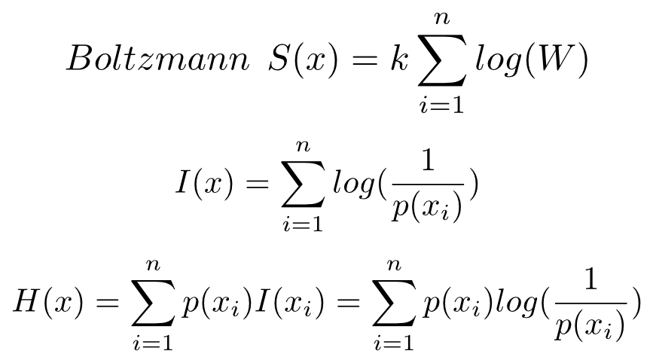
#L Shannon Information Theory
Notes:
Don’t affride. Entropy is number of microstate, in IT uncertainty, information is how much information is gained

Slide 11
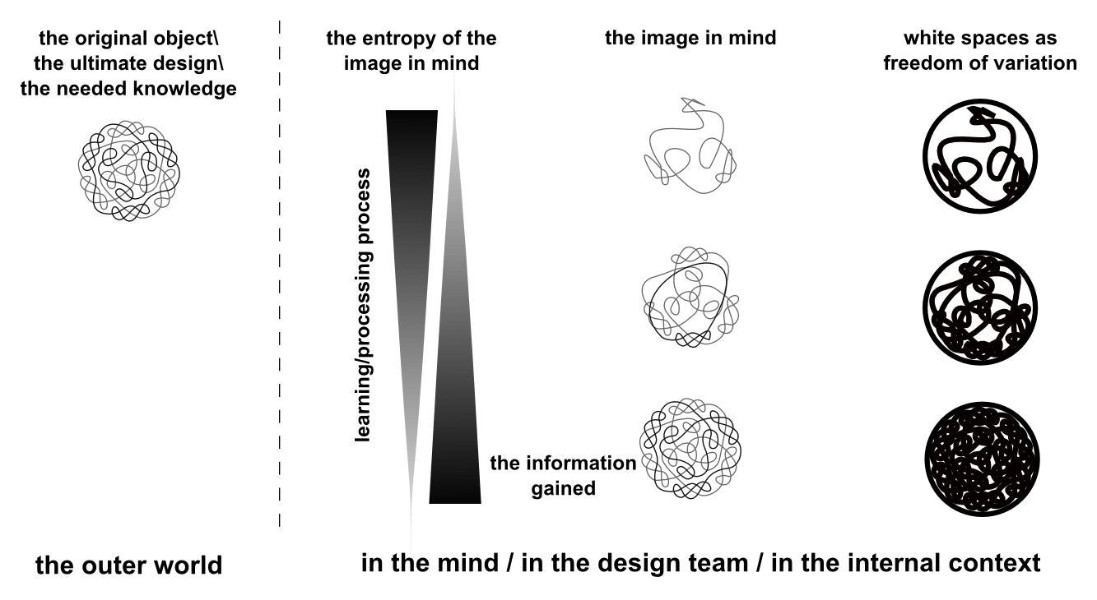
#L Shannon Information Theory From Which Perspective?
(Eivazzadeh 2012)
Notes:
Entropy from which perspective

Slide 12
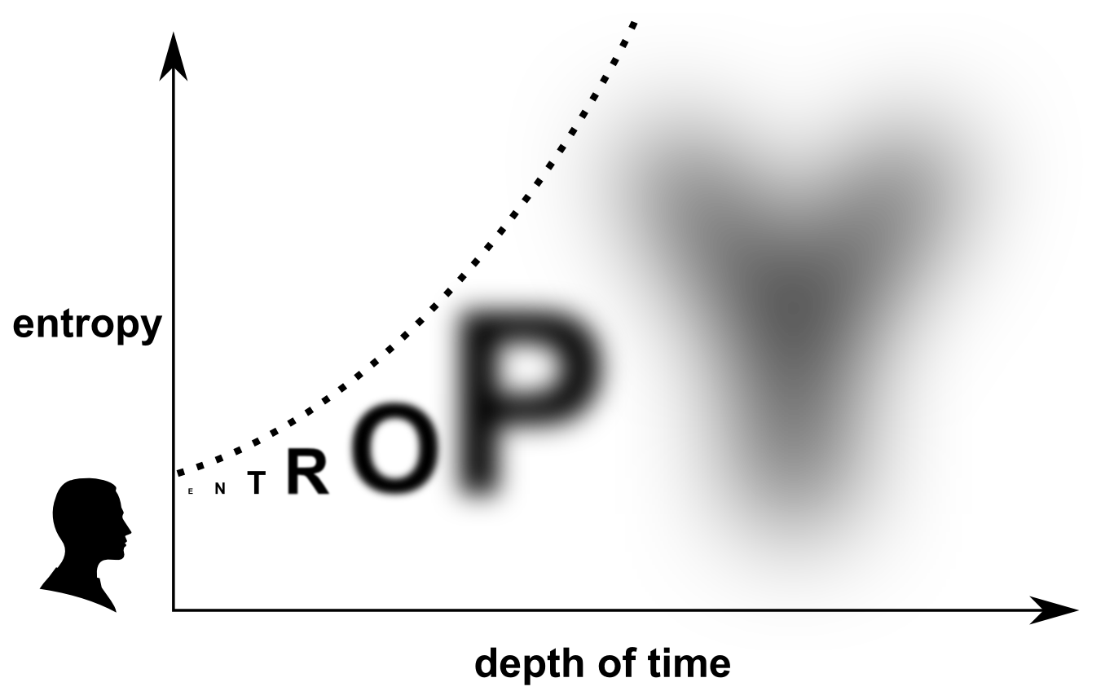
#L Shannon Information Theory Entropy of Future

Slide 13
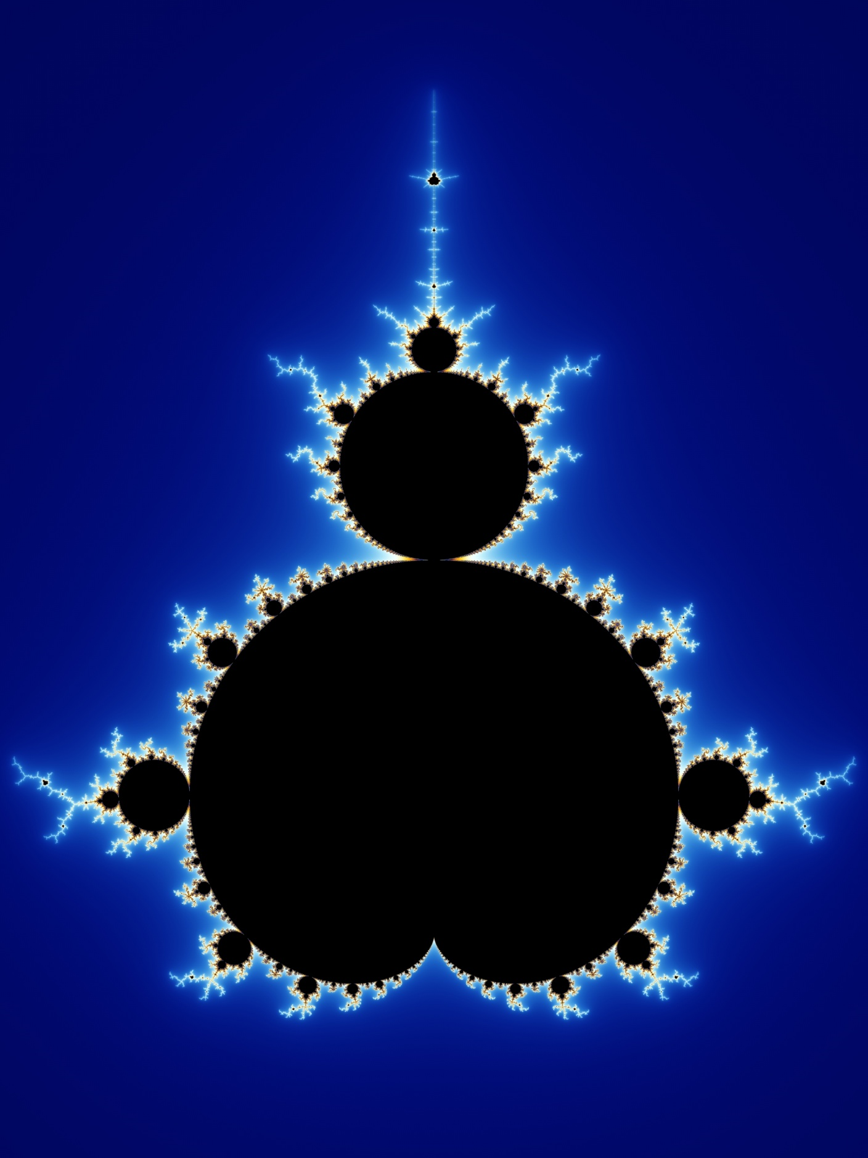
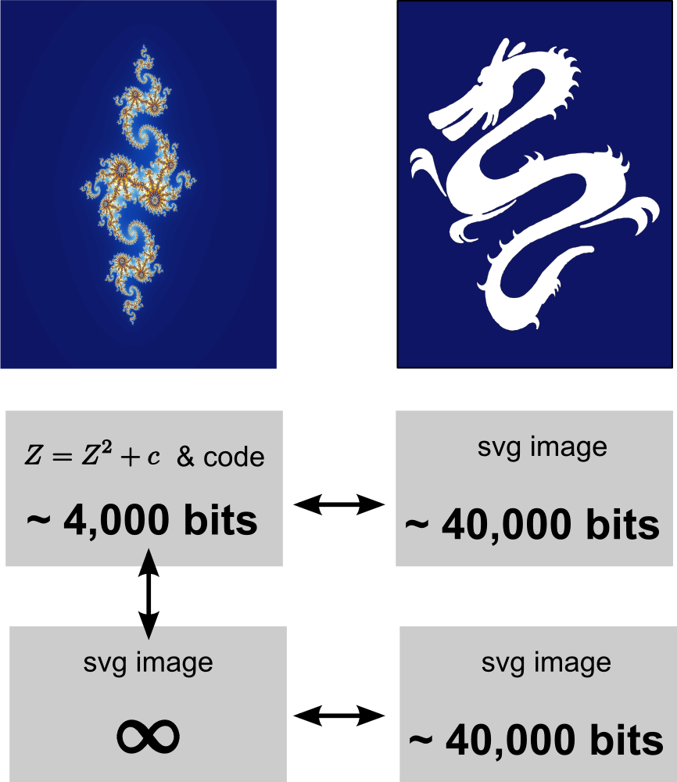
#L Algorithmic Information Size
Mendelbrot Set, Wolfgang Beyer, by Ultra Fractal3
Yves Guillou Dragon
Mendelbrot Set, Wolfgang Beyer, by Ultra Fractal3
Notes:
Another Kol, you can use it instead of Shannon, smallest description….. T create , in language or machine, . Not easy note fractals

Slide 14
#L Resilient Systems Models
Viable Systems Model (Beer)
System 1: Operation
System 2: Network
System 3: Rules & Policies
System 4: Looking to Future
System 5: Balance between the (1,2,3) and (4)
Recursion
Dynamic Capabilities Model (Teece)
Sensing
Seizing
Transforming/Managing Treats/Opportunities
Living Systems Theory (information subsystems) (Miller)
Input Transducer
Internal Transducer
Channel and Net
Timer
Decoder
Associator
Memory
Decider
Encoder
Output Transducer
Notes:
3 system inspirational

Slide 15
#M
Models

Slide 16
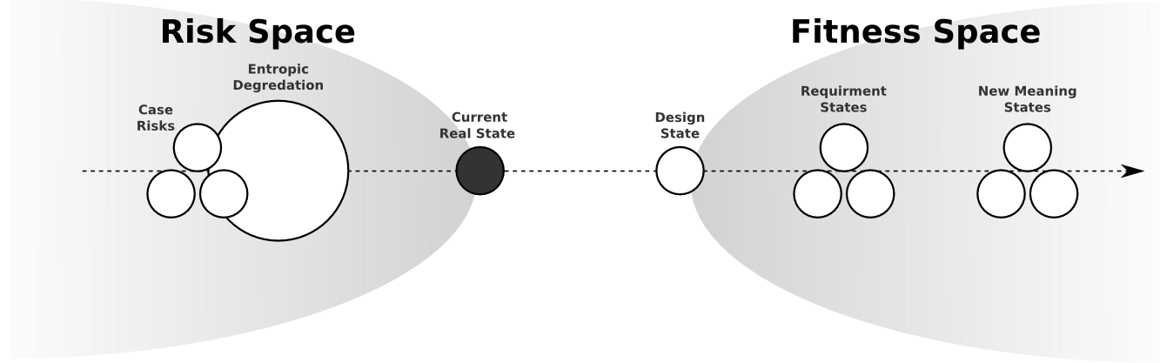
#M Dynamic State-Diagram of a Product Service System
(Eivazzadeh 2012)
Notes:
Dynamic in terms of distance changes, avoid risks , get close to design, and design to tiness , new meaning, design driven innovation

Slide 17
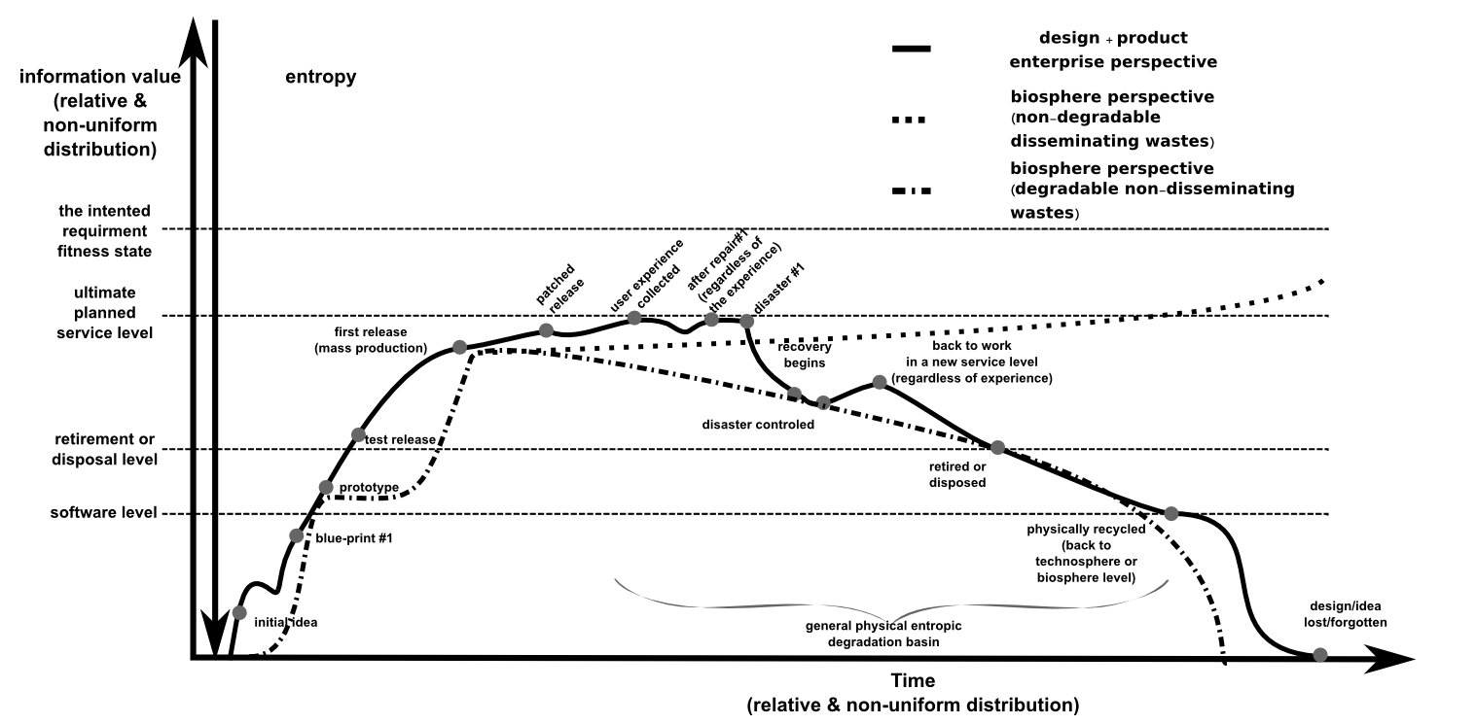
#M Information Life Cycle of a Product-Service System
(Eivazzadeh 2012)
Notes:
Life cycell, enterprise, fluctiaion , lost, biosphere is too new tries to process (and radiate)

Slide 18
#P Patterns

Slide 19
#P Patterns
Fundamental
Tactical
Structural
Notes:
Not the same level but anyway, and not complete

Slide 20
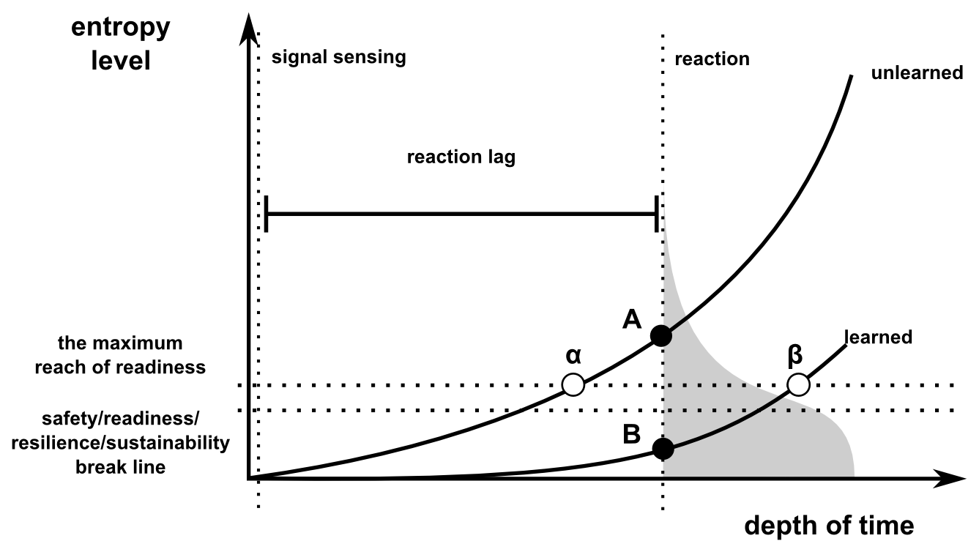
#P LSR Triad
(Eivazzadeh 2012)
Notes:
LSR, saftey distrobution, fundamental needs math

Slide 21
#R LSR Triad
Learning the future (less entropic) : increase in Latitude
Simpler future (less entropic) : increase in Latitude
Faster the Response (can avoid the in sight risks): increase in Resistance

Slide 22
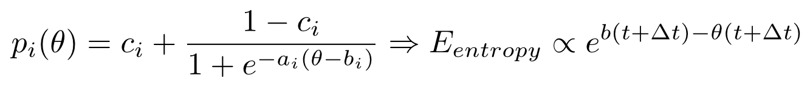
#P Learning for Future vs. On-Time Processing Balance
Item Response Theory (Baker 2001)
(Eivazzadeh 2012)
Bend Down vs Level Up the Readiness
Notes:
Bend down or level up

Slide 23
#P Learning for Future vs. On-Time Processing Balance
Educating staff vs. recruiting smart members?
Game consoles (learned/optimized about vector processing) vs. Powerful PC ( higher CPU cycles)
In the body immune system: number of Naive B-Cells vs. number of Memory B-Cells
In evolution, the mutation rate ( investing in possible future fitting genes vs. current stable genes)
Notes:
B-Cells number, mutation rate

Slide 24
#R Learning for Future vs. On-Time Processing Balance
Expands the latitude with the same amount of resources

Slide 25
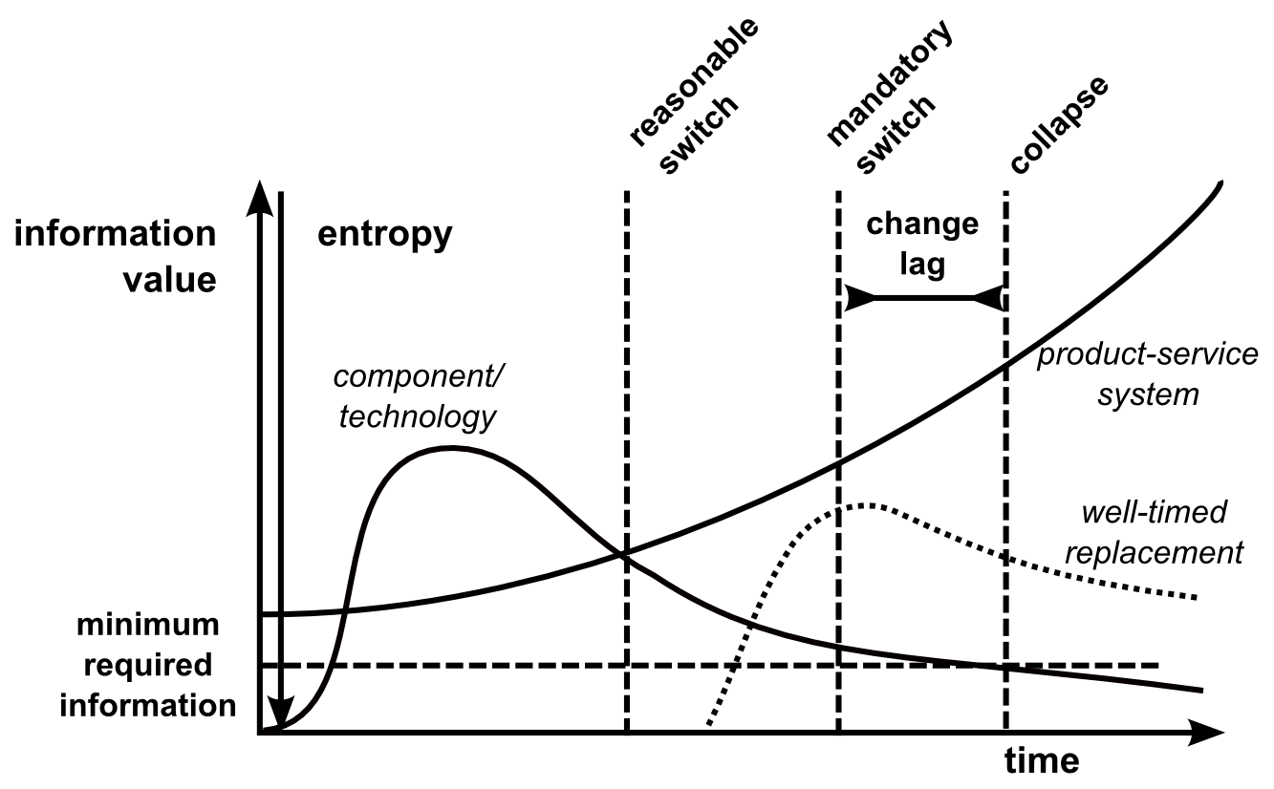
#P Information Ecdysis
(Eivazzadeh 2012)

Slide 26
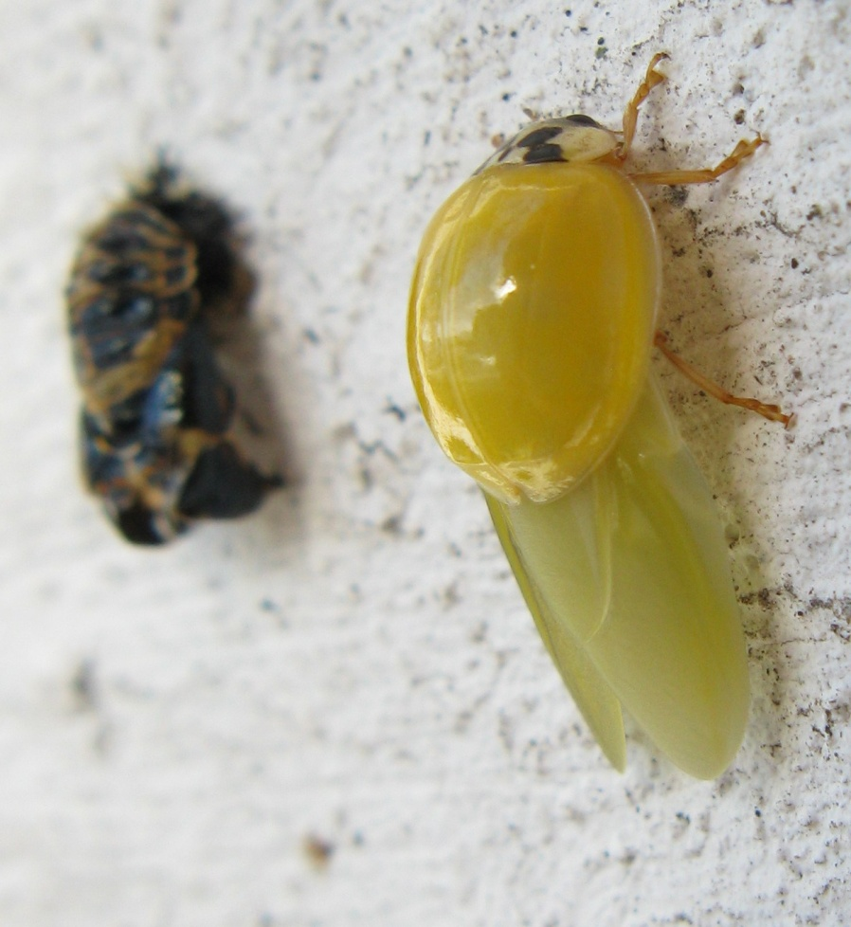
#P Information Ecdysis
Replace the people, replace the technology before any of them leave the designer team.
NASA problem (till 2012): dependency on 8086 CPUs (first used 1981)
Y2K (year 2000 crisis) problem led to problems from wrong embryo abortions to nuclear risks in Fukushima (first counter-measures initiated 1996)
Y chromosome (which is in danger of extinction) has been replaced by other sex determination systems in some rodents.
Wikipedia, John Richfield
Notes:
Replace , NASA 8086, Y2K wrong abortio, Y chromosom ..

Slide 27
#R Information Ecdysis
Decreases the precariousness of the system

Slide 28
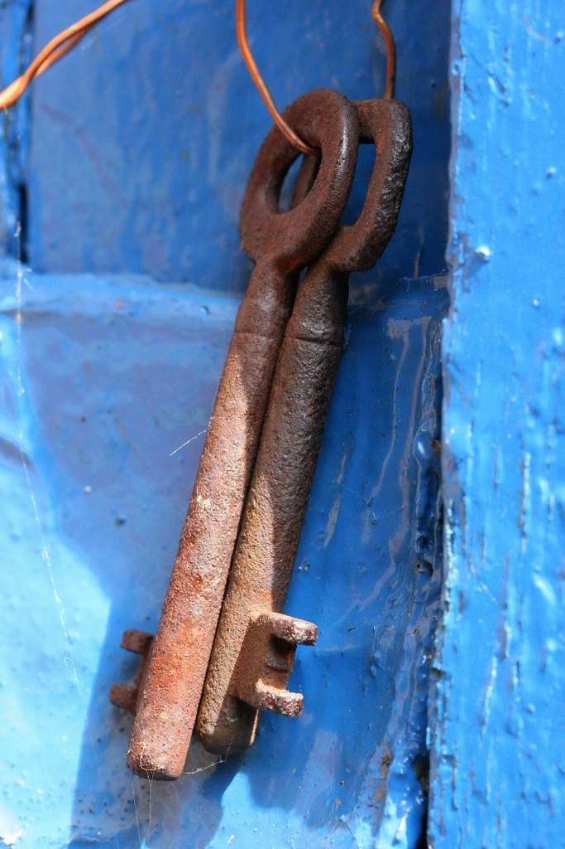
#P Smart Redundancy and Diversity
Harder to Fail by Creating More Entropy against the Adverse Environment!
Smart redundancy avoids duplication of consumption (e.g. by focusing on important parts)
Diversity adds more entropy than simple redundancy
Luc de Leeuw on Flickr
Notes:
Redundancy means simlar and eqivilent, redundacy means harder program for fail

Slide 29

#P Regeneration
Smart Redundancy Along the Time
Evolutionary regeneration is actually a diversity across the time
Kerekes Jainos Csongor on Flickr

Slide 30
#R Smart Redundancy, Diversity and Regeneration
Decrease precariousness by pushing back to the bottom of the basin

Slide 31
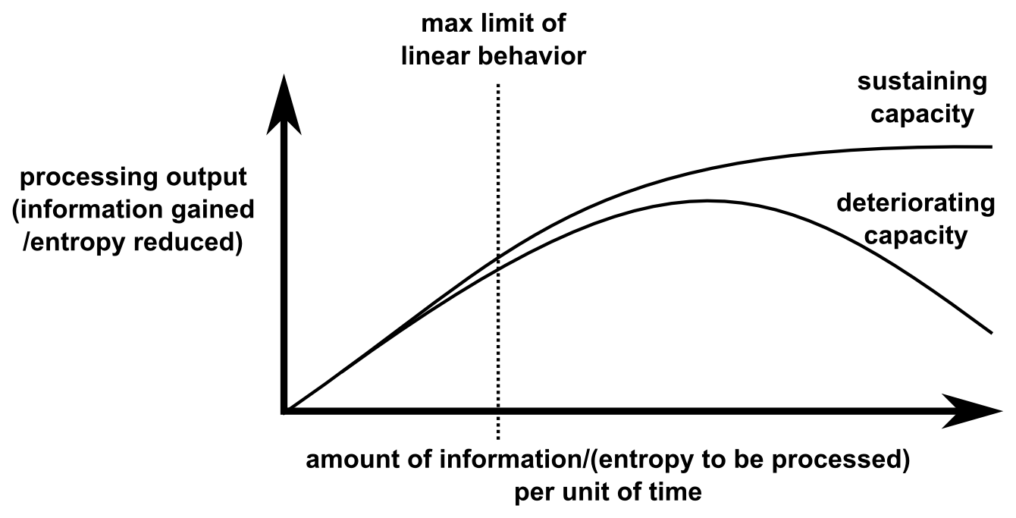
#P Processing Saturation Avoidance
(Eivazzadeh 2012)

Slide 32
#P Refactoring
Same functionality, with less information, through restructuring

Slide 33
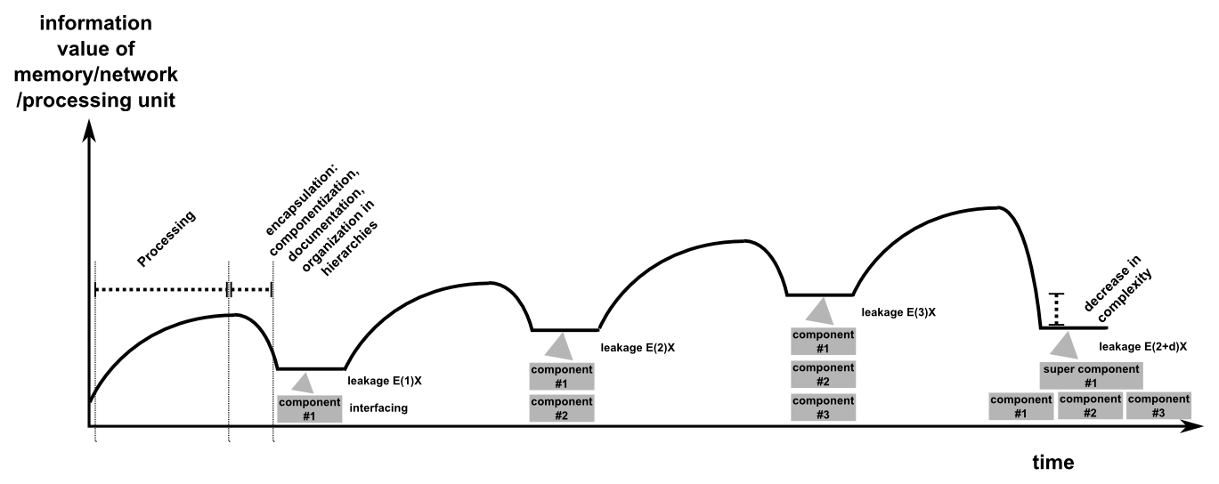
#P Encapsulation and Componentization
Hiding Information in Black-Boxes and Hierarchies
(Eivazzadeh 2012)

Slide 34
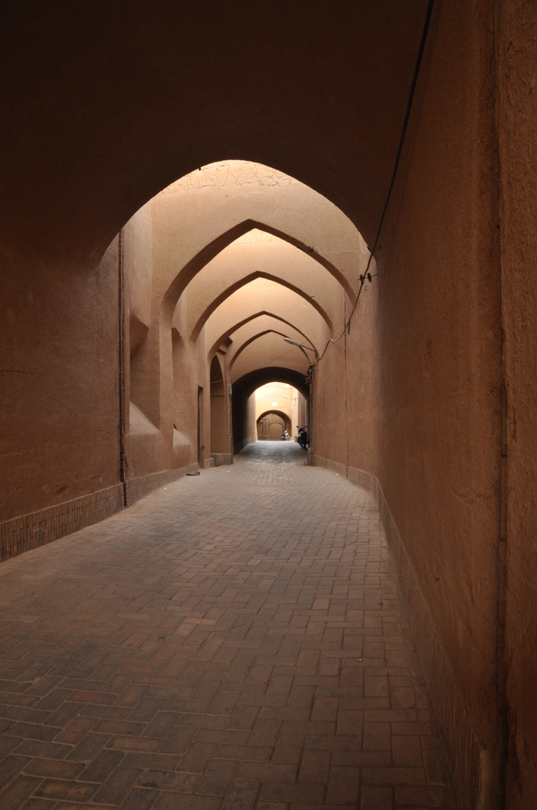
#P Recursion
A type of componentization where the higher subsystems/components in hierarchy are very similar in structure and behavior with lower ones
A kind of simpler and more compact encapsulation (less information intensive)
Similar impacts on resiliency as componentization
Yazd, Iran, Hercegnovi on Flickr

Slide 35
#R Refactoring, Encapsulation, Componentization, and Recursion
Decrease precariousness by pushing back to the bottom of the basin

Slide 36
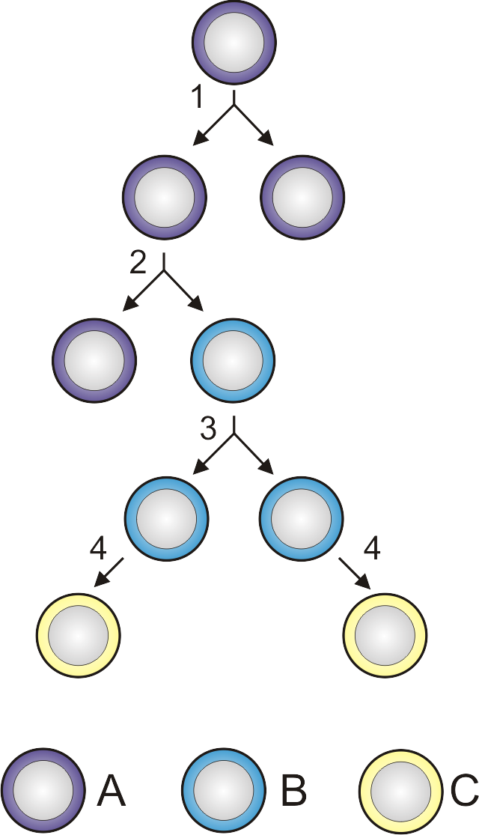
#P Stem-Cell
Information Traffic Congestion Shaping along the Time
Begins from small teams of versatile members, ends in large teams of experts
Can be applied in service teams
Is already being used in agile software development methods
Wikipedia, Public Domain

Slide 37
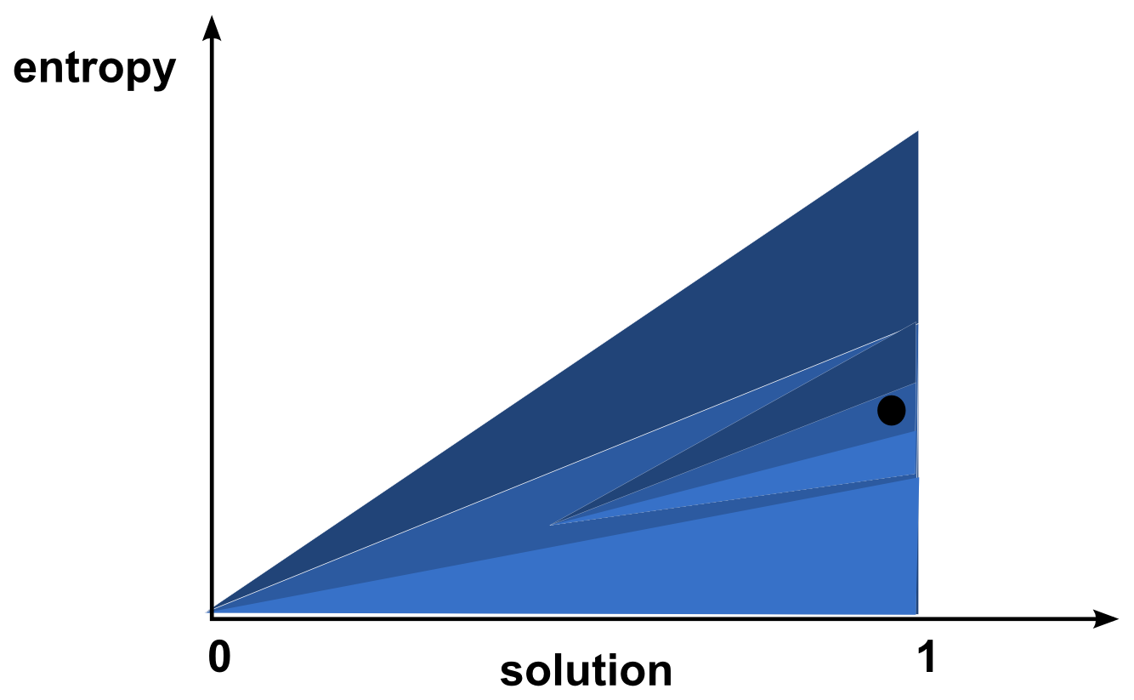
#P Cyclic Divergence and Convergence (CDC)
Divide and Conquer the Entropy Information Traffic Congestion Shaping along the Time
Making the ultimate solution entropy space smaller
Already being used (At least in extreme PSS innovation course!)

Slide 38
#R Stem Cell and CDC
Decrease resistance by resisting overflows of information/entropy

Slide 39

#P Multi-Level Fitness
Running Rhino, Credit: Allan Faustino, http://www.threadless.com/product/1000/Runnin_Rhino

Slide 40
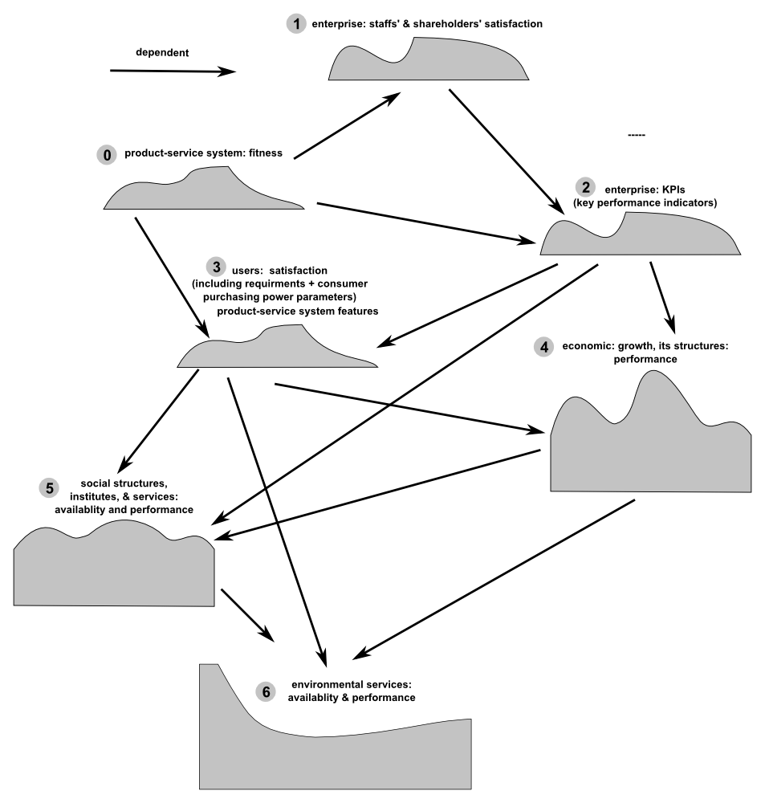
#P Multi-Level Fitness
(Eivazzadeh 2012)

Slide 41
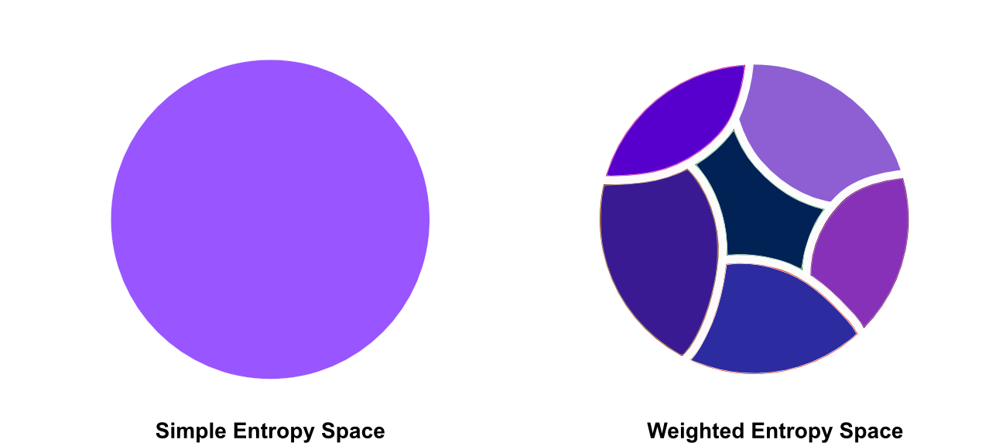
#P Multi-Level Fitness
Shaping Entropy Space Considering Interrelation of Elements, their Importance, and Impact Propagation Delay

Slide 42
#A Applications

Slide 43
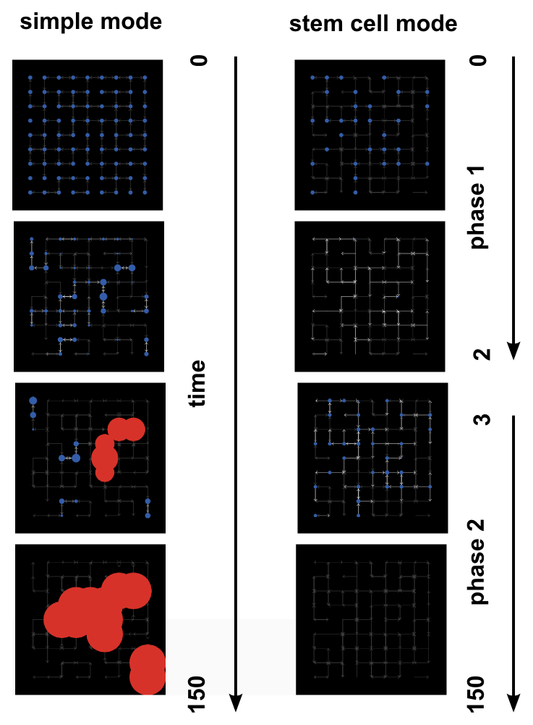
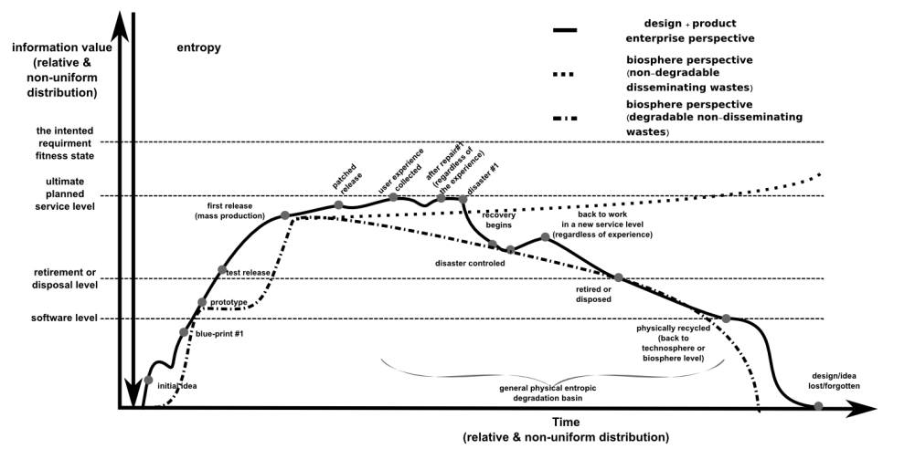
#A Stem Cell Simulation of Application in a Product-Service System
(Eivazzadeh 2012)
(Created by Netlogo 5)

Slide 44

… the sky’s dome, let us crack, and come with a new design …
Hafez (1325-1389)

